Slide 1
Yelp Data Analysis

Slide 2
Contents
 | Page
Summary | 3
Background | 4
Data Preprocessing Steps | 5
Summary Overview | 6
Supporting analysis to key findings | 7
Insight/Interesting Points | 8
Disclosures | 16

Slide 3
Contents - Appendix
 | Page
Appendices | 18
List Variables Removed | 19
Users Average Rating | 20
Dress Code | 21
Number of Reviews | 22
Price Range | 23
Accepts Credit Cards | 24
Personal Choice | 25

Slide 4
Summary

Slide 5
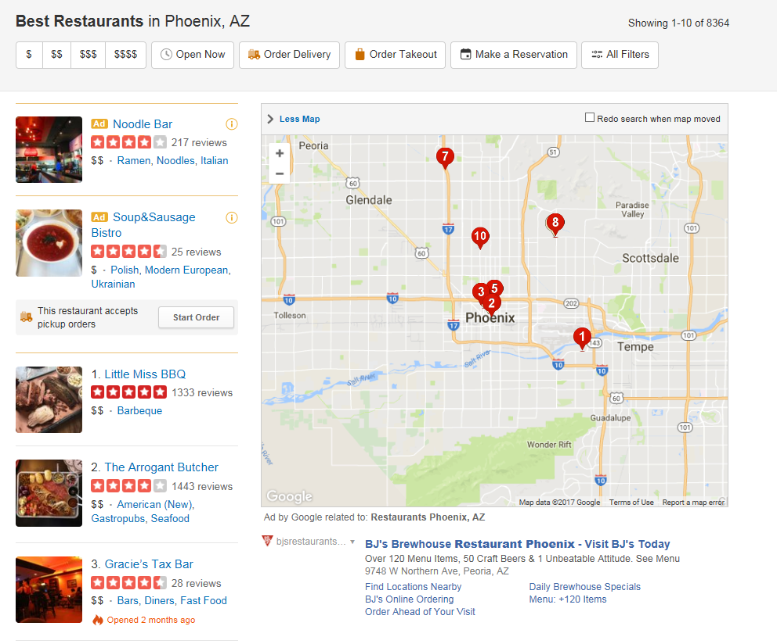
Background
Data from Yelp.com
Restaurants in Arizona
Spas, bars, and clubs marked as restaurants are included
Between January 2005 – December 2006

Slide 6
Data Preprocessing Steps
Removing Variables
All Location Variables Removed
All data from state of Arizona
Business hours and dates of reviews removed
Information about the users removed
Information about the type of business removed
Please see appendix for list of all variables removed
Python Processing
Dummy variables created
Some variables removed to avoid multicolinearity
Boolean variables transformed from T/F to 1/0
Missing data points assumed to be False or 0 for binary variables

Slide 7
Summary Overview
Individual regressions chosen based off of low p-values as well as high-impact to independent variable
Personal choice regressions were run based off of the analyst’s personal preferences
Strong correlation between Business – Stars and all remaining variables
Adjusted – R = .985
Mean of Business’s Reviews = 3.74
Results of the data did not highlight anything out of the ordinary
Users who have an average higher rating will rate a higher score
Users like dressy restaurants (between casual and formal)
The more reviews a restaurant receives the higher the rating will be
The more reviews a restaurant receives and the higher the review is the more likely the next user will rate it high as well

Slide 8
Supporting Analysis

Slide 9
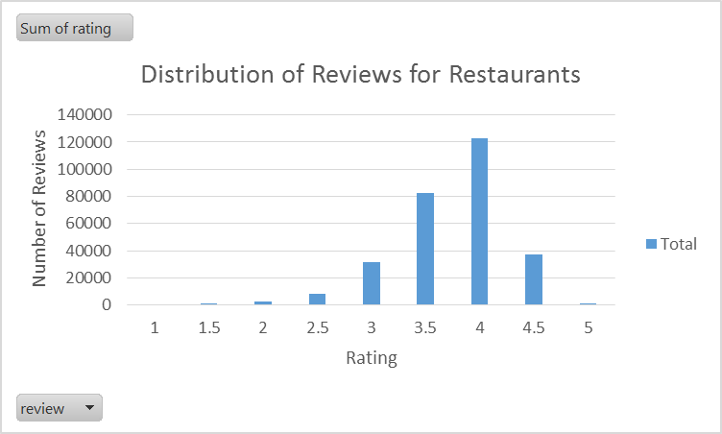
Insight/Interesting Points
High-Impact Variables
Being able to use credit cards
Dress code of the restaurant
Noise Level of the restaurant
Regressions run
Users’ Average Rating
Dress Code
Number of Reviews
Price Range
Accepts Credit Cards
Personal Choice

Slide 10
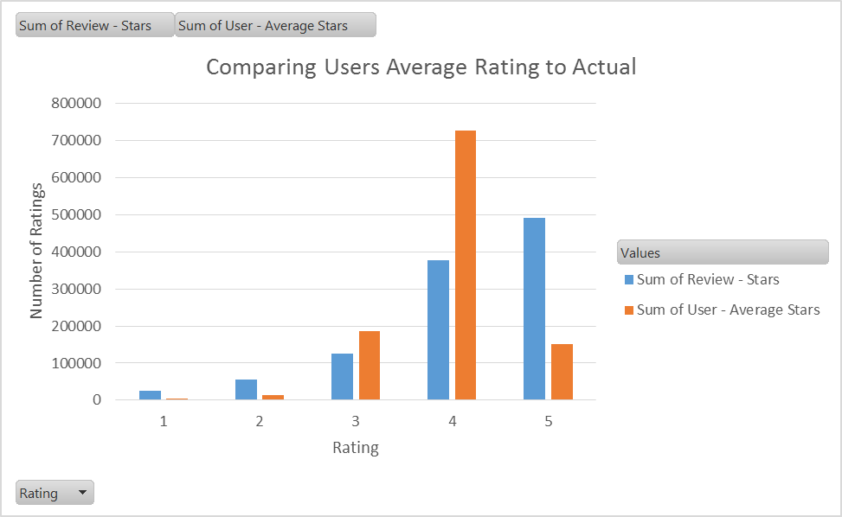
Users’ Average Rating
Summary
The regression was run to compare a User’s Average against the rating they would give a restaurant
Analysis
The higher a user’s average rating is the more likely they were to give a higher review for a restaurant
Conclusion
A person is more likely to give a restaurant a high rating if they give other restaurants high ratings
More people rate restaurants when they have a good time rather than a bad time

Slide 11
Dress Code
Summary
The regression was run to examine how the dress code of the restaurant would affect its rating
Analysis
Please note the dummy variable removed was “formal”
The more “dressy” a restaurant is, the higher the rating will be, however, at a certain point, a restaurant becomes too “formal” and the ratings go down
Conclusion
Although people value nice restaurants, if they are too nice, ratings go down because the expectations for those restaurants go up

Slide 12
Number of Reviews
Summary
The regression was run to examine how the number of reviews a restaurant had correlated with the overall rating of that restaurant.
Analysis
The greater number of reviews a restaurant has, the more likely it is to have a higher overall rating.
Conclusion
The more reviews a restaurant has means more people have eaten there. If more people have eaten at the restaurant the rating should increase because if it was bad people would not eat there.

Slide 13
Price Range
Summary
The regression was run to examine how the price range of the restaurant affects its rating
Analysis
Please note that the adjusted R squared is less than .01 suggesting a very low correlation
The more pricy the restaurant the more likely it is to have a better rating
Conclusion
Due to the very low correlation between the two variables it is easy to say that the price of the restaurant does not affect the rating
However, because this dataset is not sorted by types of restaurants (chains, fine-dining, casual bars), the analysis is incomplete to determine if the price of the restaurant affects it’s overall rating

Slide 14
Accepts Credit Cards
Summary
The regression was run to examine the impact of a restaurant accepting credit cards has on its rating
Analysis
Please note that the adjusted R squared is less than .01 suggesting a very low correlation
If a restaurant accepts credit cards, the more likely it will have a higher rating
Conclusion
Due to the very low correlation between the two variables it is easy to say that accepting credit does not affect the rating
However, this can be over looked because most restaurants in this dataset accept credit cards. Rather it should be noted that if a restaurant does not accept credit cards it would have a greater affect on their rating.

Slide 15
Personal Choice
Summary
The regression was run to examine the impact of the variables that were important to the analyst when choosing a restaurant
Analysis
Please note the following dummy variables were removed:
no_bar
yes_smoking
If a restaurant accepts credit cards, the more likely it will have a higher rating, all else being equal
If a restaurant has a happy hour, the more likely it will have a lower rating, all else being equal
If a restaurant has a TV, the more likely it will have a lower rating, all else being equal
If a restaurant serves just beer and wine, the more likely it will have a higher rating than if it has a full bar or no bar, all else being equal
If a restaurant does not allow smoking, the more likely it will have a higher rating than if it has outdoor smoking or allows smoking, all else being equal
Conclusion
The analysis shows that a happy hour and a TV are less likely to favorable qualities of a restaurant, while accepting credit cards, serving just beer and wine, and not allowing smoking are more favorable qualities of a restaurant leading to higher ratings

Slide 16
Disclosures

Slide 17
Problems with the data
Lots of missing data points
Same restaurant with different names
Unavoidable multicolinearity in the data
Example: Places good for dancing (bars, clubs, etc.) not good for kids
Duplicate columns “Good for Kids”
Wide variety of restaurants
Fast-food to casual-bars to high-class restaurants

Slide 18
Appendix

Slide 19
List of Variables Removed
Business - Monday Close
Business - Saturday Close
Business - Friday Open
Business - Saturday Open
Business - Monday Open
Business - Sunday Close
Business - Sunday Open
Business - Wednesday Close
Business - Thursday Close
Business - Wednesday Open
Business - Thursday Open
Business - Tuesday Close
Business - Tuesday Open
Business - Restaurant?
User - Years Elite
Business - Friday Close
Number of Records
Business - Accepts Insurance
Business - Ages Allowed
Business - Alcohol
Business - Attire
Business - BYOB/Corkage
Business - By Appointment Only
Business - Dietary Restrictions
Business - Noise Level
Business - Parking
Business - Payment Types
Business - Smoking
Business - Wi-Fi
Business - Categories
Business - City
User - Compliments Cool
User - Compliments Cute
User - Compliments Funny
User - Compliments Hot
User - Compliments List
User - Compliments More
User - Compliments Note
User - Compliments Photos
User - Compliments Plain
User - Compliments Profile
User - Compliments Writer
Review - Date
User - Fans
Business - Address
Latitude
Longitude
User - Name
Business - Name
Business - Neighborhoods
Business - Open?
User - Review Count
Review - Id
Business - State
User - Votes Cool
Review - Votes Cool
User - Votes Funny
Review - Votes Funny
User - Votes Useful
Review - Votes Useful
User - Yelping Since

Slide 20
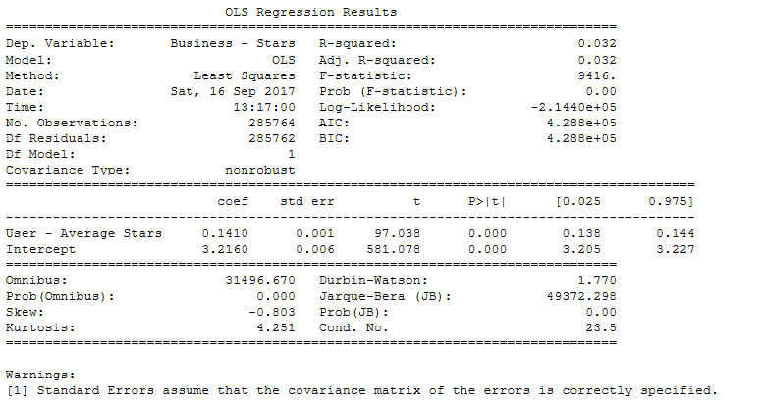
Users Average Rating

Slide 21
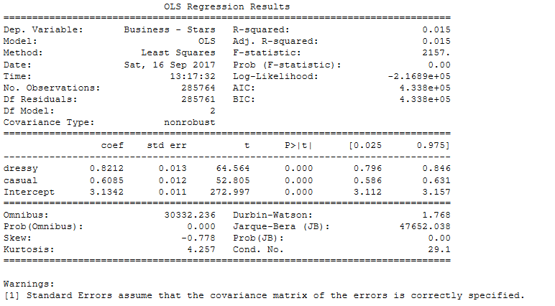
Dress Code

Slide 22
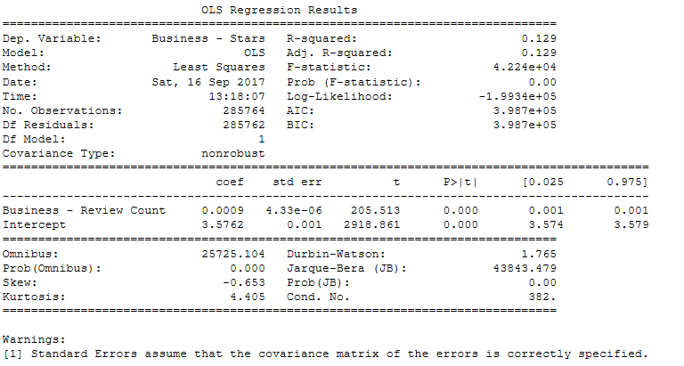
Number of Reviews

Slide 23
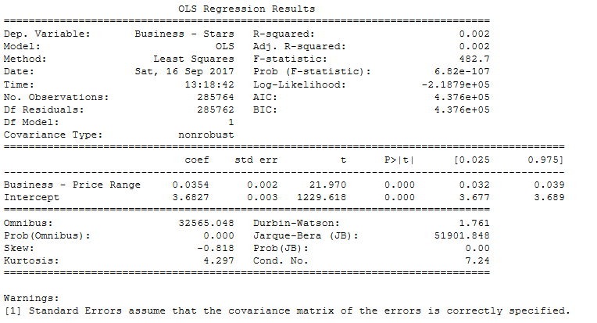
Price Range

Slide 24
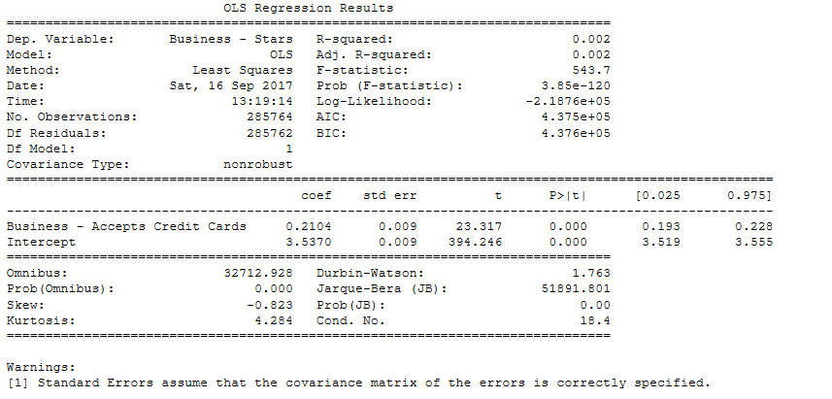
Accepts Credit Cards

Slide 25
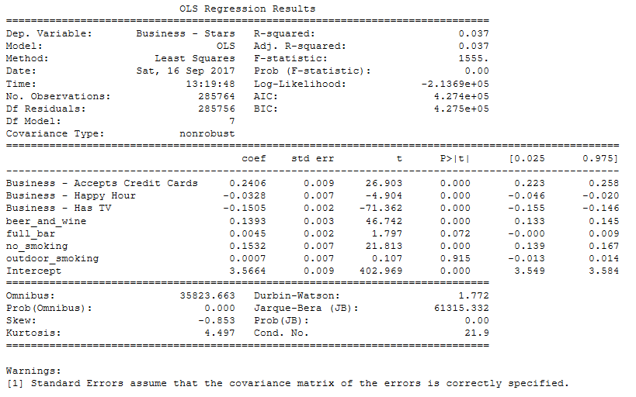
Personal Choice

Slide 26
Thank you

Slide 27
kpmg.com/socialmedia
The information contained herein is of a general nature and is not intended to address the circumstances of any particular individual or entity. Although we endeavor to provide accurate and timely information, there can be no guarantee that such information is accurate as of the date it is received or that it will continue to be accurate in the future. No one should act on such information without appropriate professional advice after a thorough examination of the particular situation.
© 2016 KPMG LLP, a Delaware limited liability partnership and the U.S. member firm of the KPMG network of independent member firms affiliated with KPMG International Cooperative (“KPMG International”), a Swiss entity. All rights reserved.
The KPMG name and logo are registered trademarks or trademarks of KPMG International.

